Slide 1
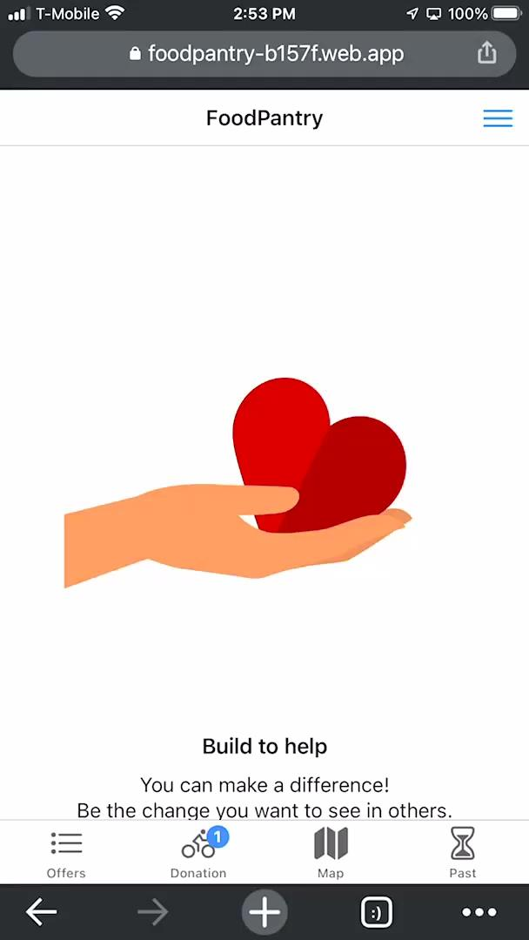


Food Pantry - Demo
Web app

